Slide 1
CI and CD using
AWS DevOps Tools

Slide 2

DevOps
Pipeline
Source
Developers
commit
changes
Build
Changes
are built and
unit tested
Staging
Code deployed to staging and load/UI tested
Production
Code is deployed to production
Developers
Customers
Changes, updates, and
fixes
Ideas, requests, and
bugs

Slide 3
How to use CodeDeploy

Slide 4
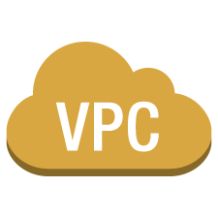






GitHub Repo
EC2-001
CodeDeploy
User Commits
EC2-002
CodeDeploy
VPC subnet
Virtual private cloud

Slide 5
How to use CodeDeploy and CodePipelines

Slide 6


EC2-001
CodeDeploy
GitHub Repo
EC2-001
User Commits
CodePipeLine
CodeDeploy
VPC subnet
Virtual private cloud

Slide 7
Thank You

